Slide 1
Classification using CNN
Lalit Jain https://www.linkedin.com/in/lalit7jain/
Rohit Agarwal https://www.linkedin.com/in/rohitag04/
Shivam Goel https://www.linkedin.com/in/goelshi/
Hina Gandhi: https://www.linkedin.com/in/hina-gandhi-52834356/
Big Data & Engineering Systems
Under the guidance of Professor. Dino Konstantopoulos

Slide 2
Agenda
Case Study
Building a Convolutional Neural Network
Time Complexity
Using VGG16 model
Limitations & Challenges
Future Scope
Demo

Slide 3

Case Study
Building a CNN model which can be trained on the fly and classify objects

Slide 4
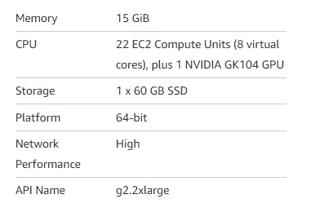
Approach
Using Flickr API download the images from the front end
Prepare the image by cleaning and augmentation
Train the model based on the image downloaded with Convolutional Neural Network using Keras and Tensorflow
Classify the image
Technology Stack:
Programming Language: Python
Front End: Django Framework
Machine Specifications:
Libraries: Keras, Tensorflow, VGG16, etc

Slide 5
Data Set Description

Slide 6
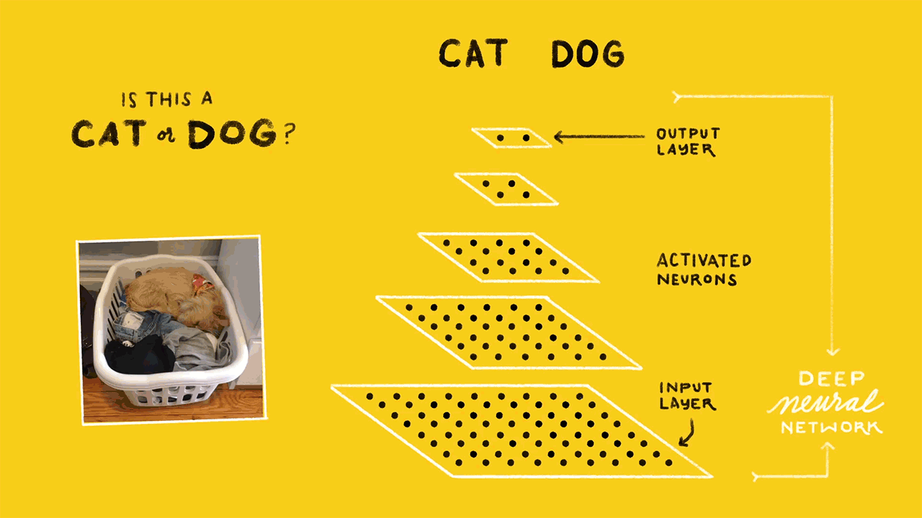
Convolutional Neural Network

Slide 7



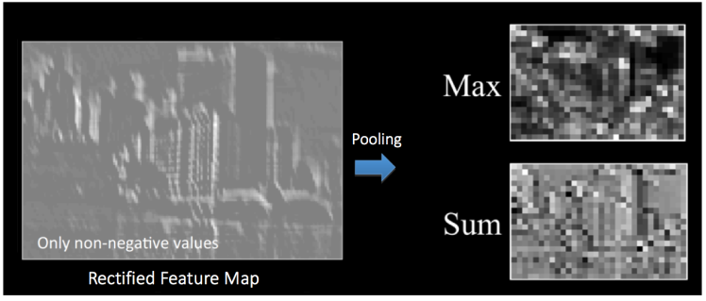
Images are a matrix of pixel values
Convolution Operation
Relu Activation
Pooling (Max)

Slide 8
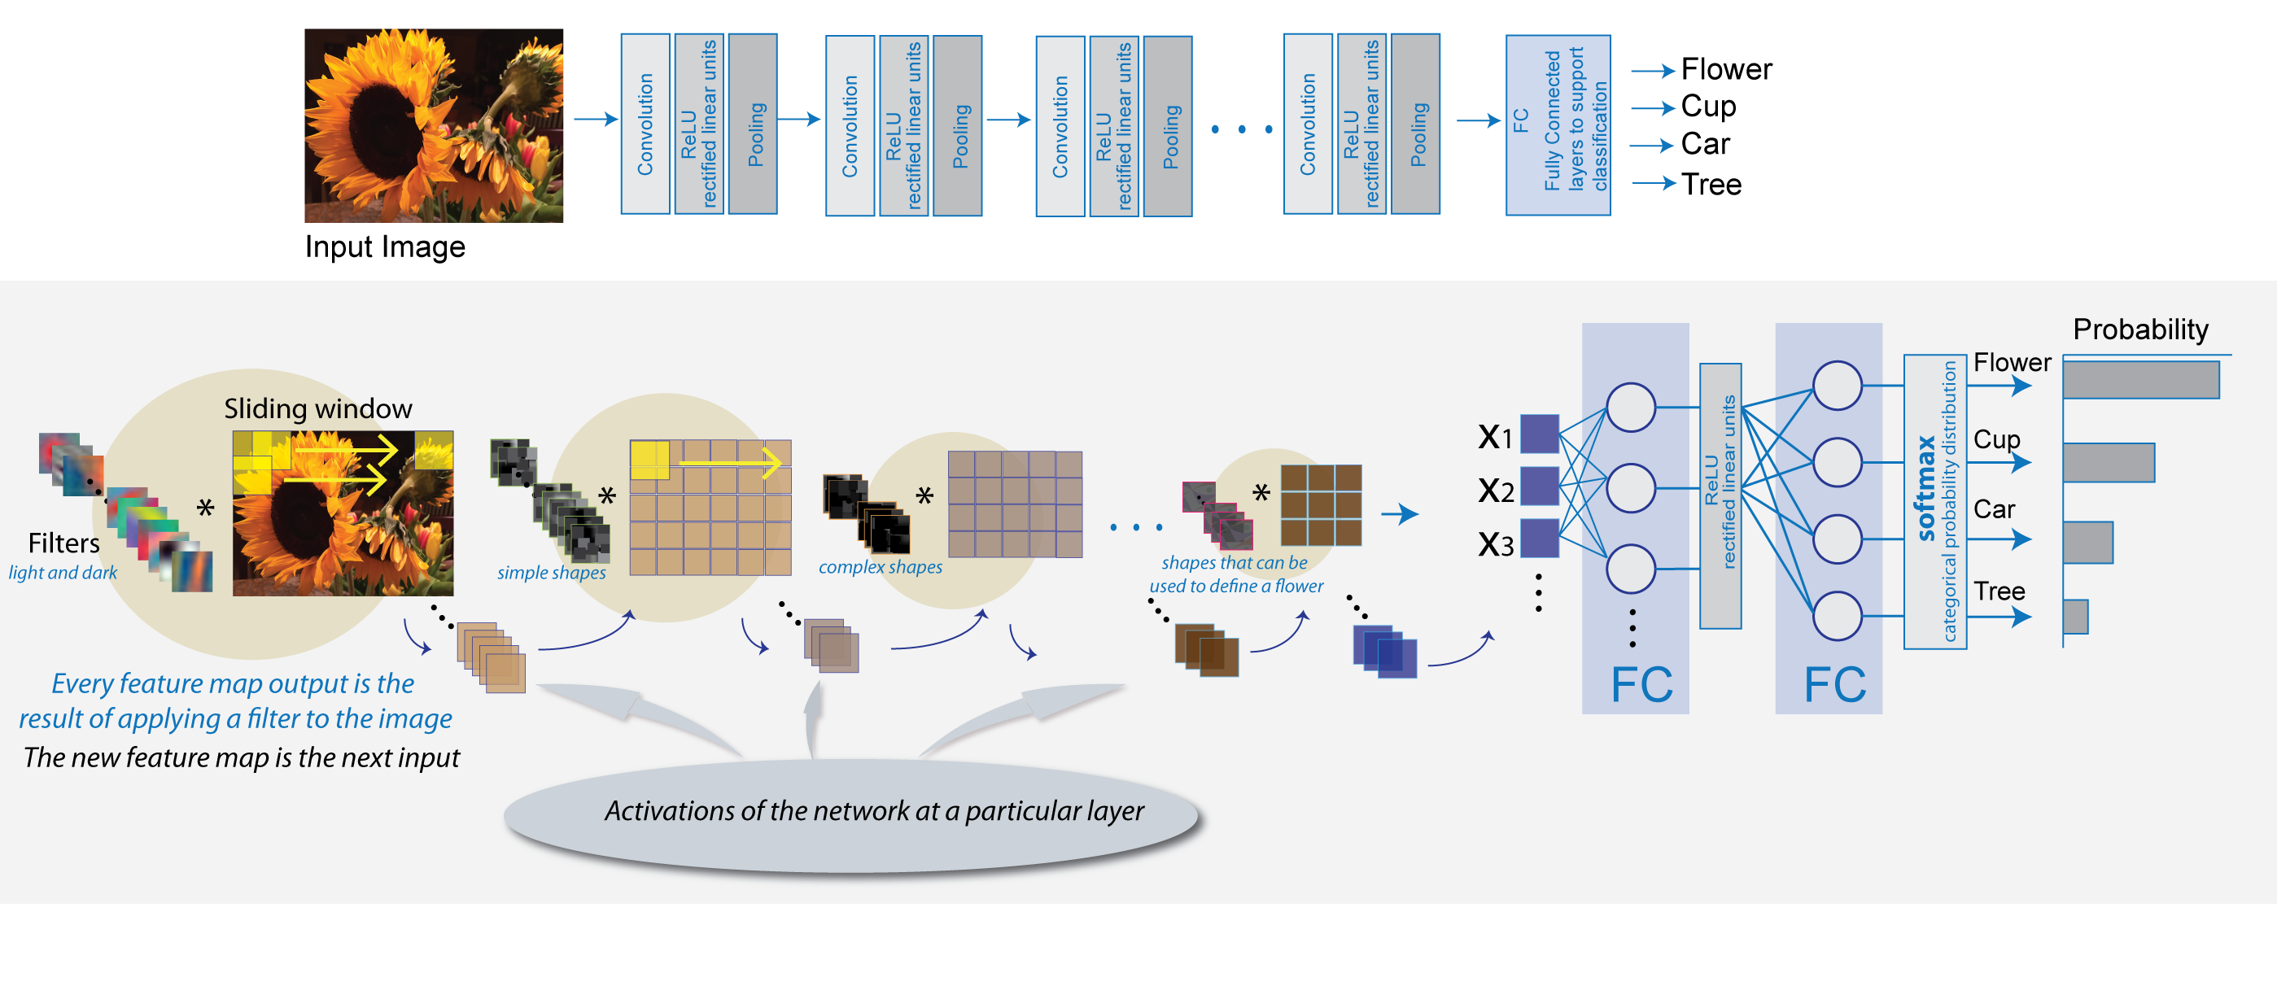
Putting it all together

Slide 9
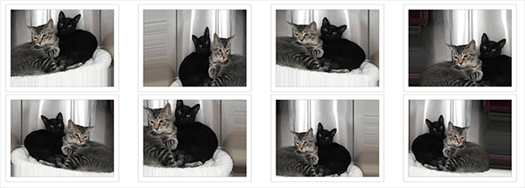
Data augmentation for improving the model
By applying random transformation to our train set, we artificially enhance our dataset with new unseen images.
shear_range: Rotate image by 0.2
zoom_range: Zoom the image by 0.2
horizontal_flip: Randomly flip inputs horizontally.
rescale: rescaling factor (1./255)

Slide 10
CNN complexity

Slide 11

VGG16 Pre-Trained Model
The model achieves 92.7% top-5 test accuracy in ImageNet, which is a dataset of over 14 million images belonging to 1000 classes.
Citation:
https://arxiv.org/pdf/1409.1556.pdf

Slide 12
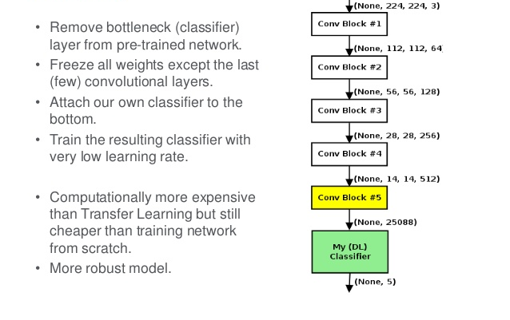
Fine tuning the VGG16 Model

Slide 13
DEMO
We have taken two datasets :
One dataset is related to natural calamities where we have trained our models for 4 classes “earthquake”, “hurricane”, “tornado” and “volcanic eruption”.
Other dataset is related to personality identification where we have taken famous personalities like “Obama” and “Trump”. Today, you will tell us some other famous personality and we will train our model for that.

Slide 14
CHALLENGES
1. Limitation of Google API custom search to return only 10 images.
2. Compressing large size images before writing to disk.
3. Basic CNN model took more than 8 hours to run from scratch
4. The total images in all the classes should be same and the batch size should be the GCD of total images in train and test classes.
5. Django installation and other software installations required lot of configurations in GPU instance
6. Tried to install quiver engine for visualization of each convoluted layer.

Slide 15
Future Scope
1. Facial key point detection
2. Analysis of satellite images for disaster detection
3. Real Time Criminal Detection through Video analysis

Slide 16
Thank You
References:
https://districtdatalabs.silvrback.com/modern-methods-for-sentiment-analysis
https://www.zybuluo.com/HaomingJiang/note/462804
https://xkcd.com/1425/
http://cs231n.stanford.edu/reports/2016/pdfs/267_Report.pdf
https://en.wikipedia.org/wiki/Kernel_(image_processing)
https://adeshpande3.github.io/adeshpande3.github.io/A-Beginner's-Guide-To-Understanding-Convolutional-Neural-Networks-Part-2/
http://culurciello.github.io/tech/2016/06/04/nets.html
https://en.wikipedia.org/wiki/Convolutional_neural_network

